Slide 1
SoC Final Project
Team04
R13943009 鄭至盛
R13943021 陳品睿

Slide 2
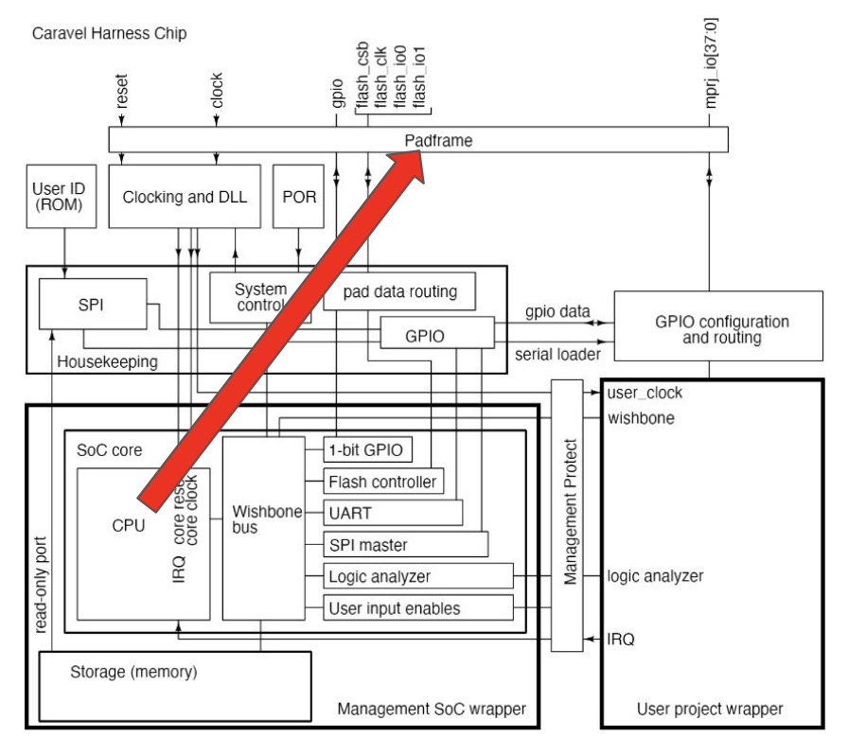
Architecture:
Top Module:
User Project
IPs:
Uart, Exmem, Wb2axi, FIR, MM, Qsort
Improvements:
SDRAM, DMA
Metrics:
Computing cycles
EXMEM
WB2AXI
RAM
DataRAM
FIR
MM
Qsort
TapRAM

Slide 3
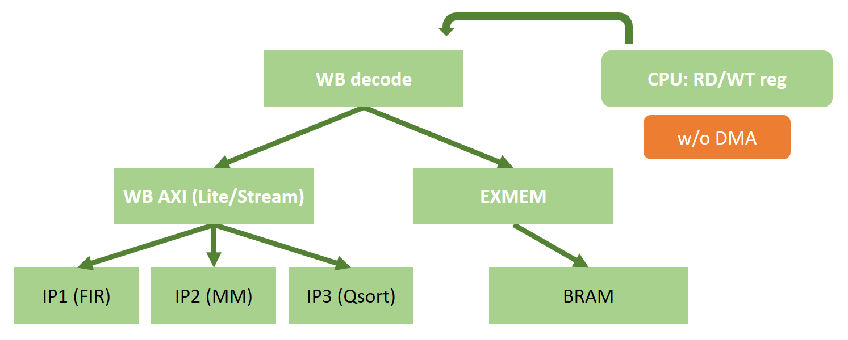
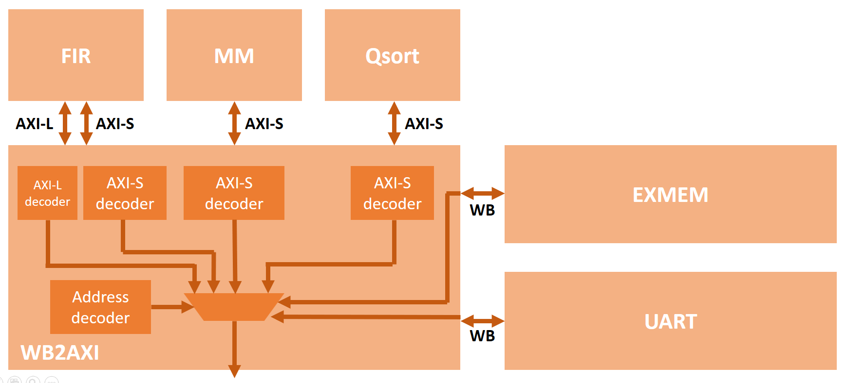
First Version (WB2AXI):

Slide 4
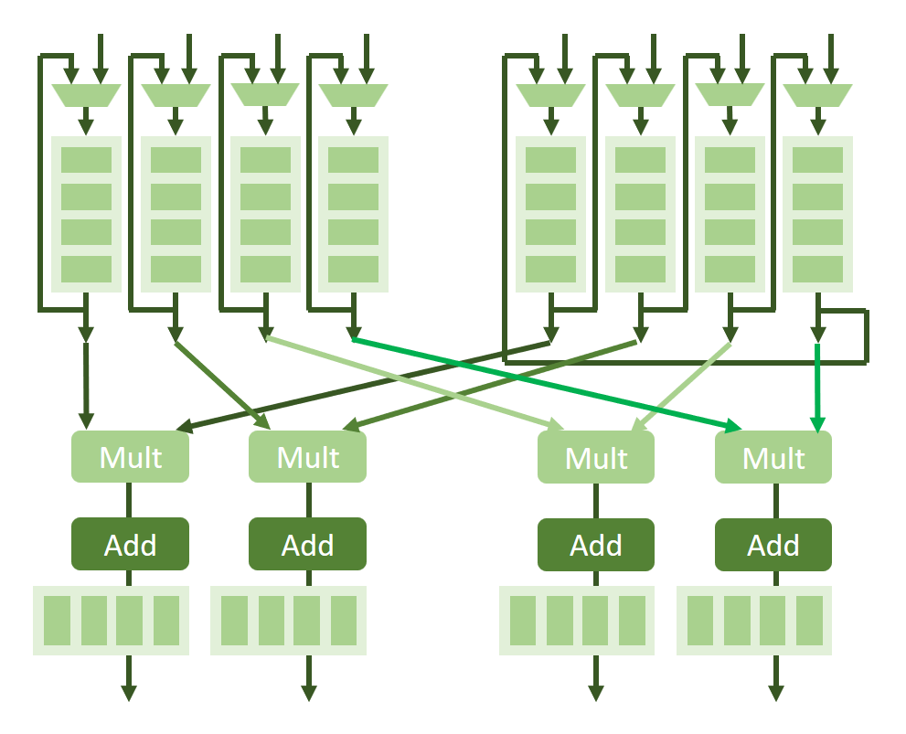
First Version (MM):
Interface:
AXI-Stream
Storage:
4x4 32bit register files for A, B, C
Controller:
Respective control logic for MM
Computation:
4 multipliers & 4 adders

Slide 5
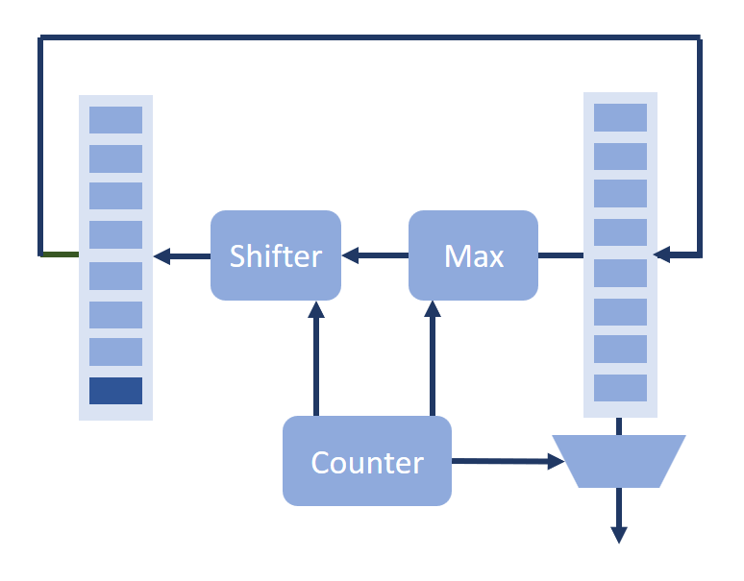
First Version (Sort):
Interface:
AXI-Stream
Storage:
10 32bit register files for Q
Controller:
Respective control logic for Qsort
Computation:
10-elements comparator & shifter

Slide 6
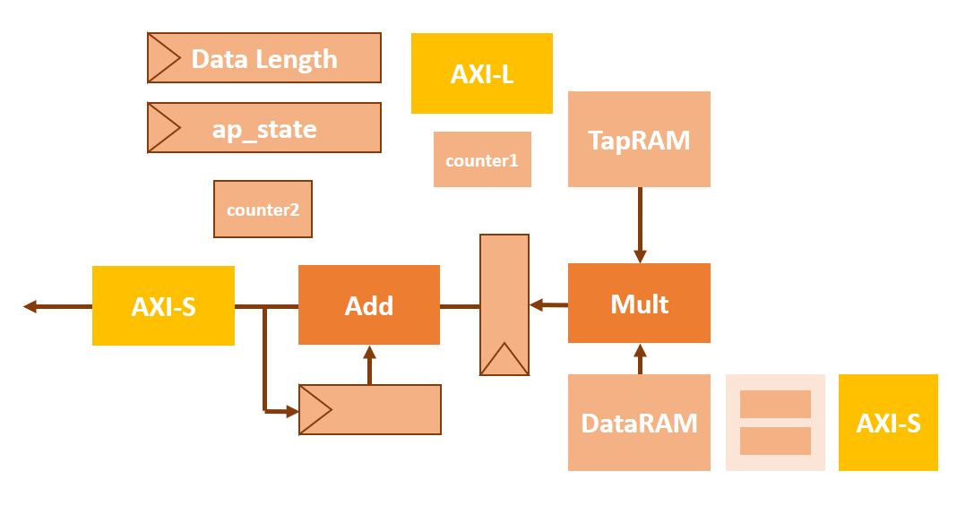
First Version (FIR):
Interface:
AXI-Stream, AXI-Lite
Storage:
11 elements Tap_RAM & Data_RAM
Controller:
Respective control logic for fir
Computation:
1 multiplier & 1 adder

Slide 7
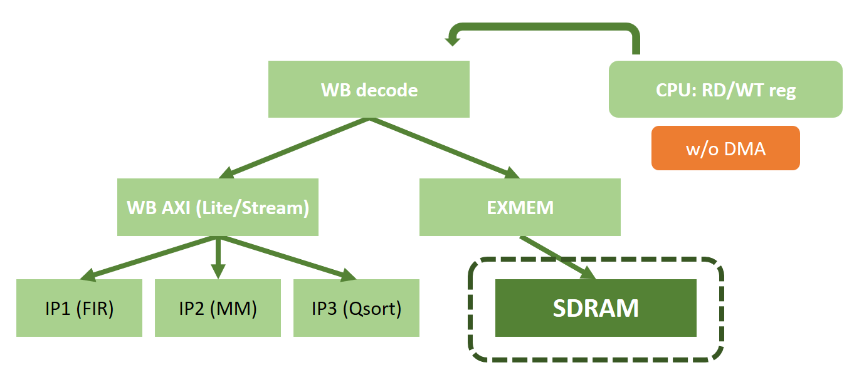
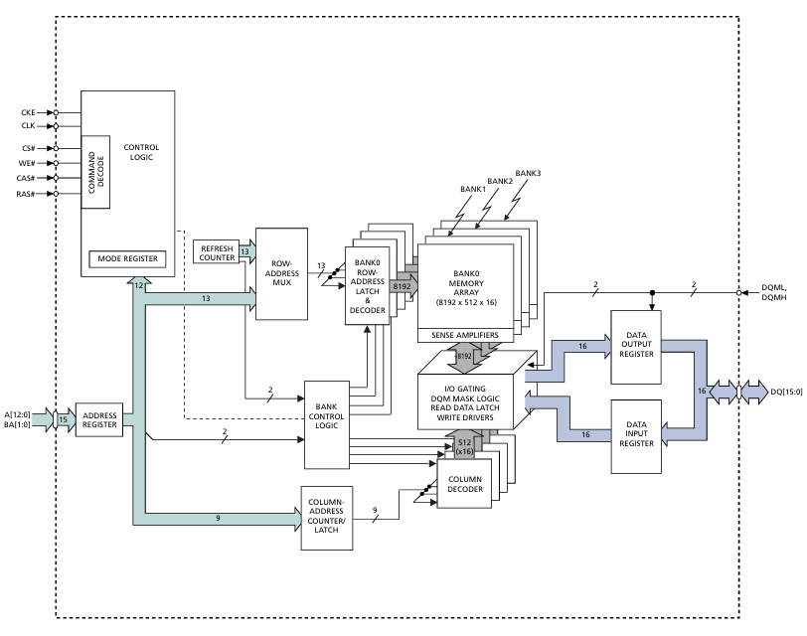
2nd Version (SDRAM):
Memory Module:
Micron MT48LC64M4A2
(4x4banks x 16Meg)
Controller state:
CAS, Precharge, Activate Latency: 3T
Refresh Latency: 7T
Refresh cycle: 750T
We didn’t provide special design to interleave data & instructions

Slide 8
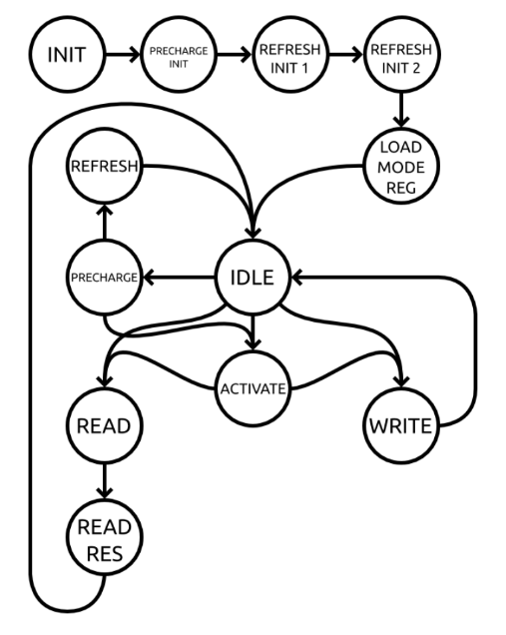
2nd Version (SDRAM):
EXMEM
 | Ver. 1 | Ver. 2 | Improvement
FIR | 39712 | 31033 | 21.8%
MM | 21055 | 16496 | 21.6%
Qsort | 7043 | 5638 | 19.9%
WB
SDRAM Controller
SDRAM interface
SDRAM
write data
out_valid
read data
Ref: https://alchitry.com/sdram-mojo

Slide 9
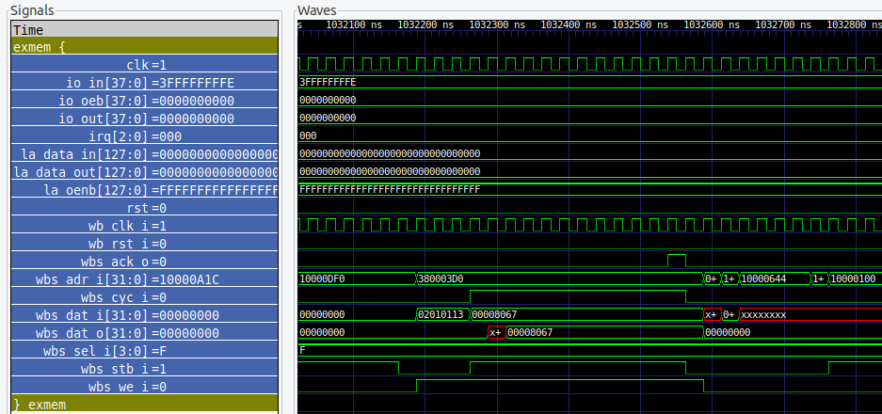
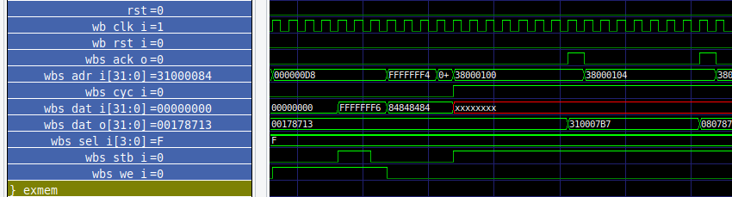
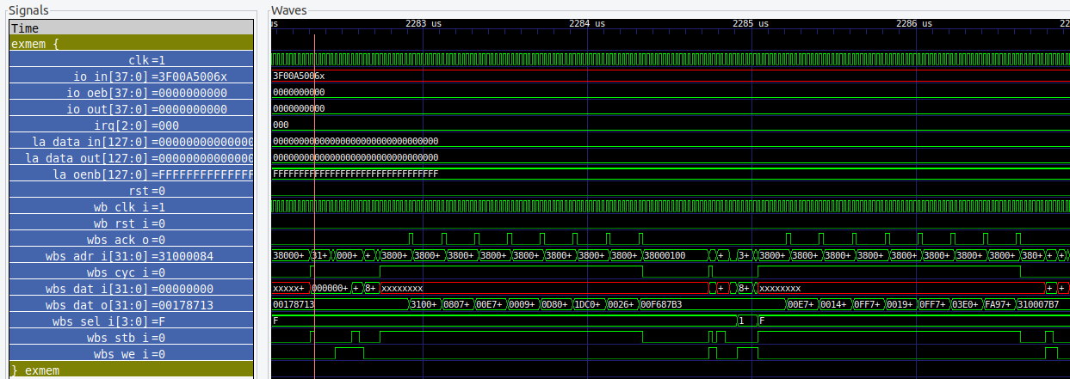
2nd Version (SDRAM):
BRAM version
8 cycles
12 cycles in total
SDRAM version

Slide 10
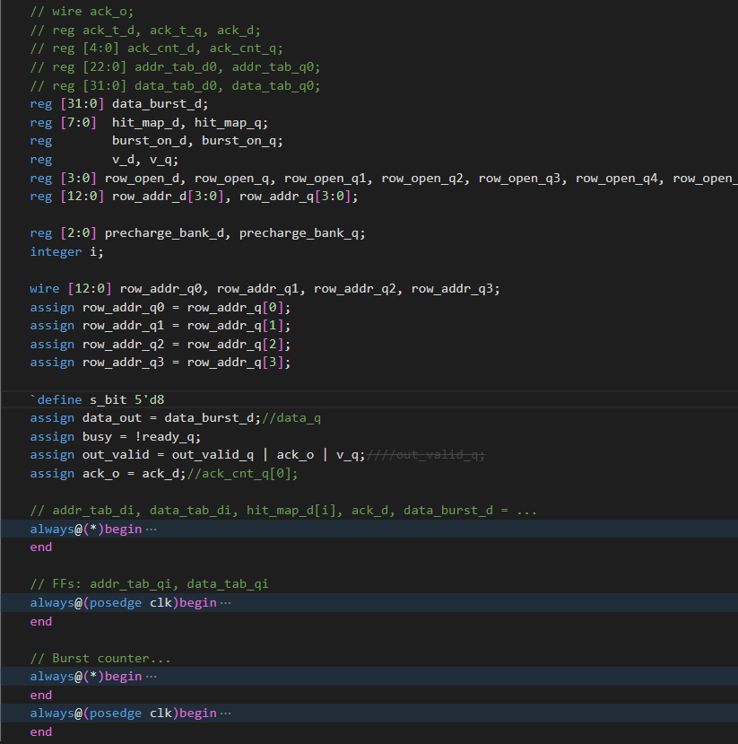
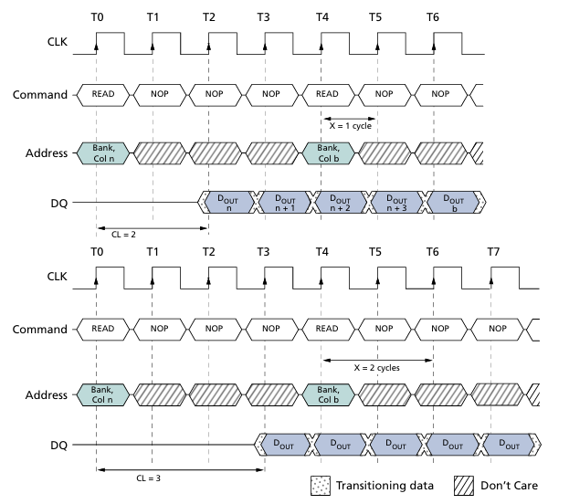
3rd Version (+burst):
burst

Slide 11
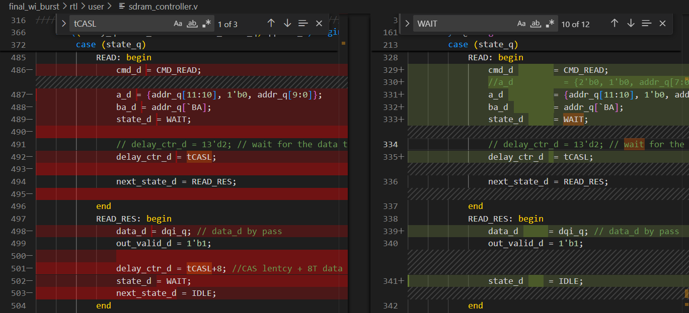
3rd Version (+burst):
burst
 | Ver. 2 | Ver. 3 | Improvement
FIR | 31033 | 16804 | 45.8%
MM | 16496 | 8977 | 45.6%
Qsort | 5638 | 3363 | 40.4%
+8 extra cycles
Ref: https://alchitry.com/sdram-mojo

Slide 12
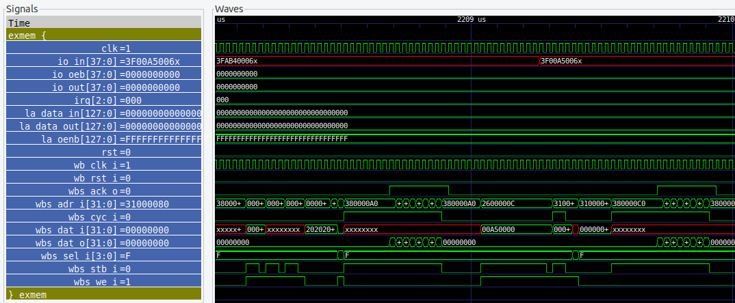
3rd Version (+burst):
burst
SDRAM version + burst
In our experiment, it seems like that wbs_stb_i can actually be always high.
8 cycles
8 cycles
SDRAM version

Slide 13
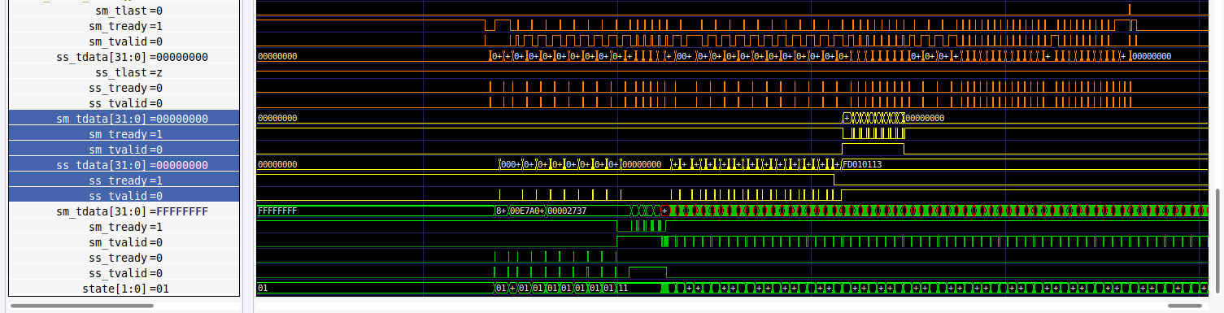
4th Version (+DMA):
FIR
Matmul
 | Ver. 3 | Ver. 4
FIR | 16804 | 1877
MM | 8977
Qsort | 3363
Qsort

Slide 14
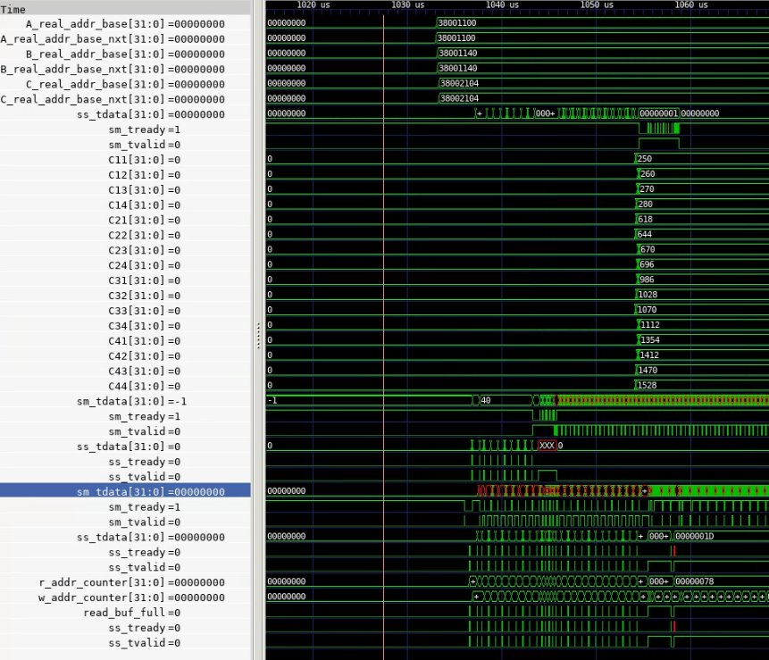
4th Version (+DMA):
mul
FIR
 | Ver. 3 | Ver. 4
FIR | 16804 | 3984
MM | 8977
Qsort | 3363

Slide 15
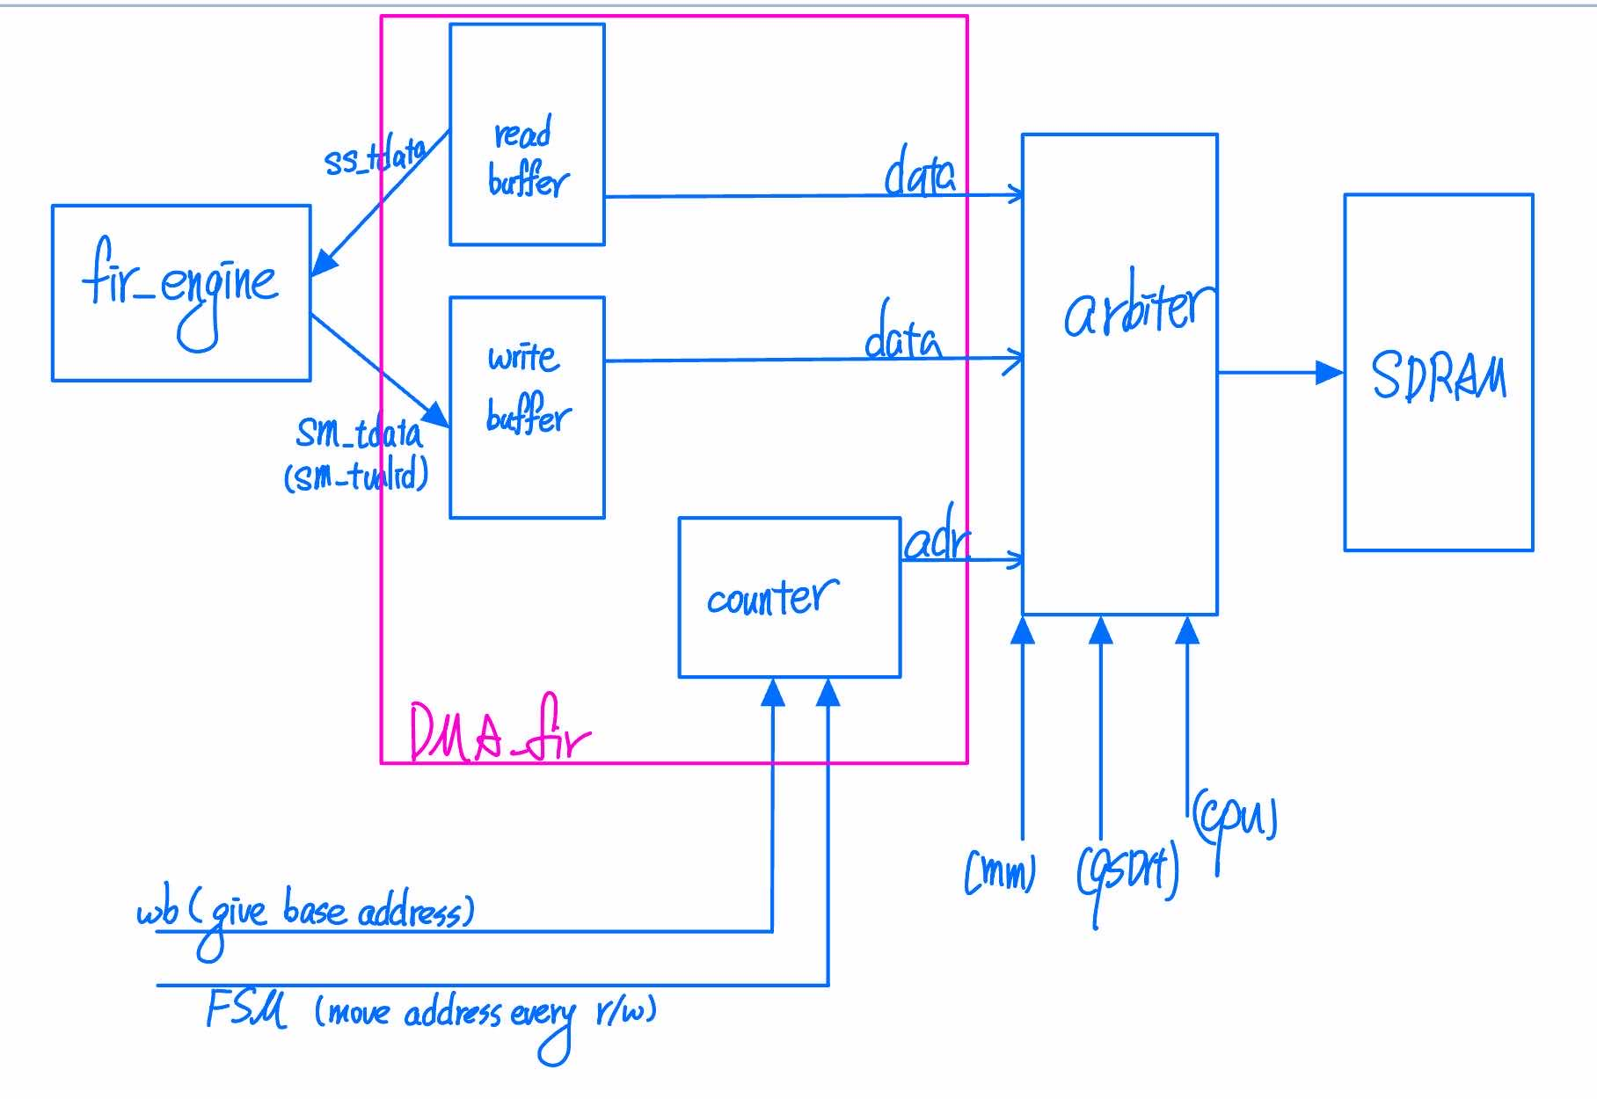
DMA Interact

Slide 16
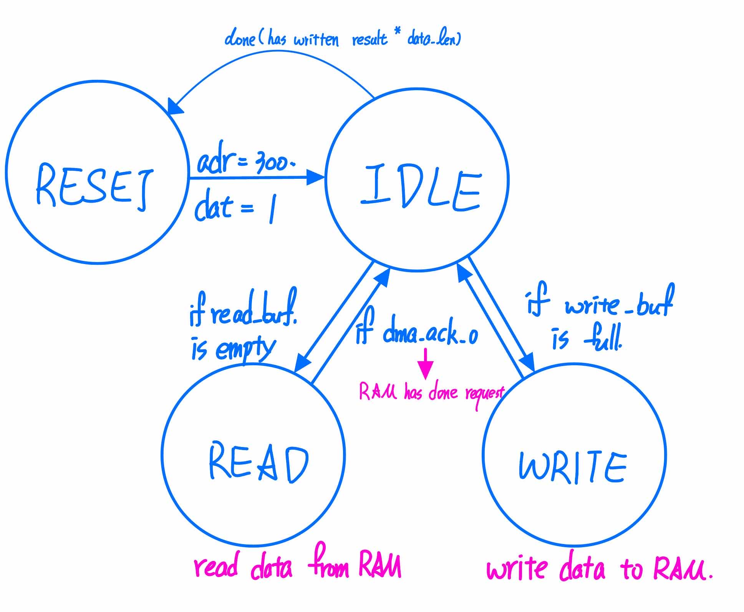
DMA Finite State Machine

Slide 17
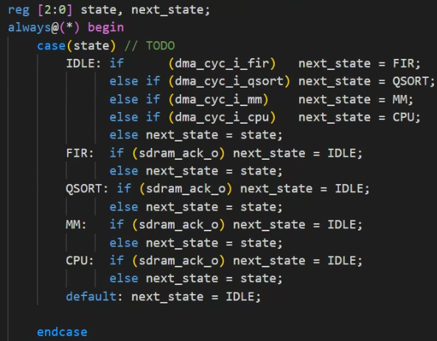
arbiter
Priority: FIR > QSORT > MM > CPU

Slide 18
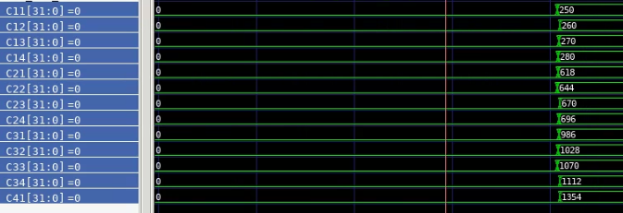
Functional Correctness:
Get correct answer for matrix multiplication

Slide 19
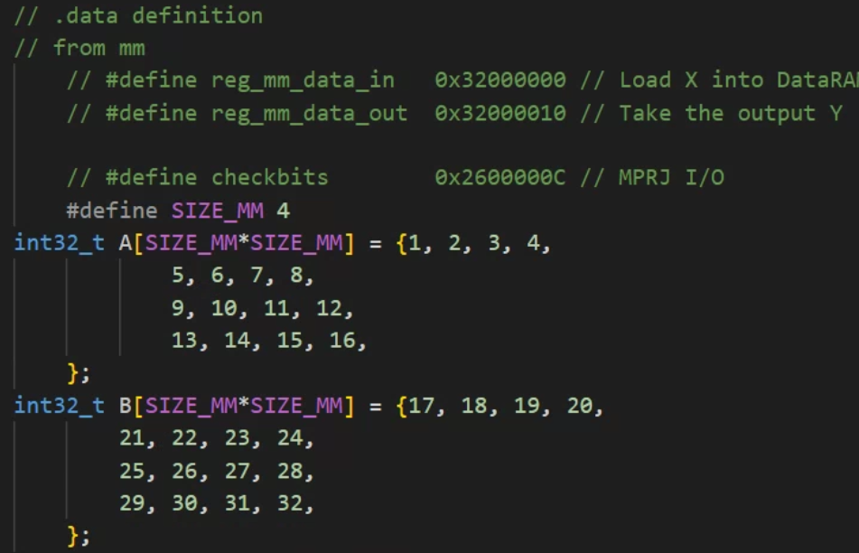
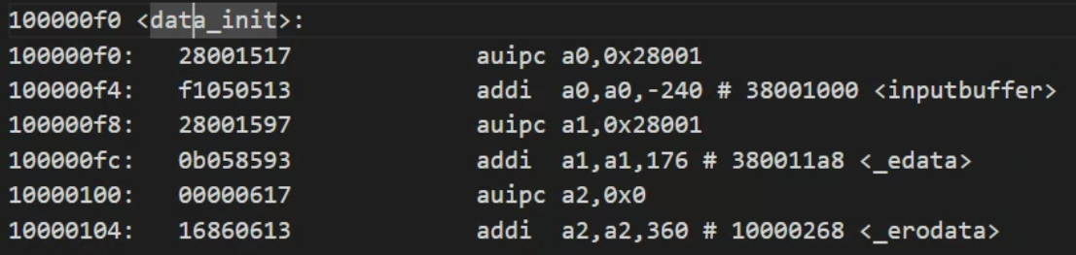
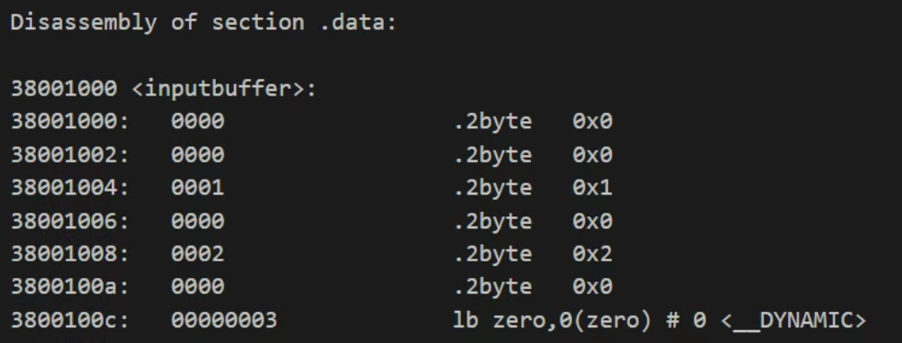
Data transfer
before main:
Move predefined data to RAM

Slide 20
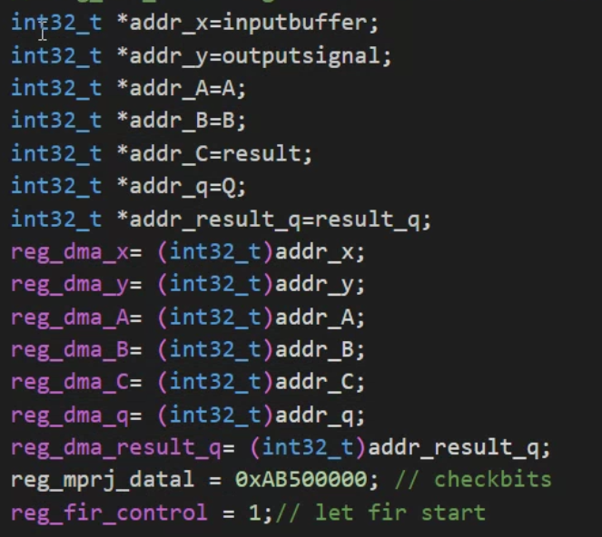
Data transfer
in main:
Tell DMA where these data located
Data at Reg_dma_x stores the base address of inputbuffer

Slide 21
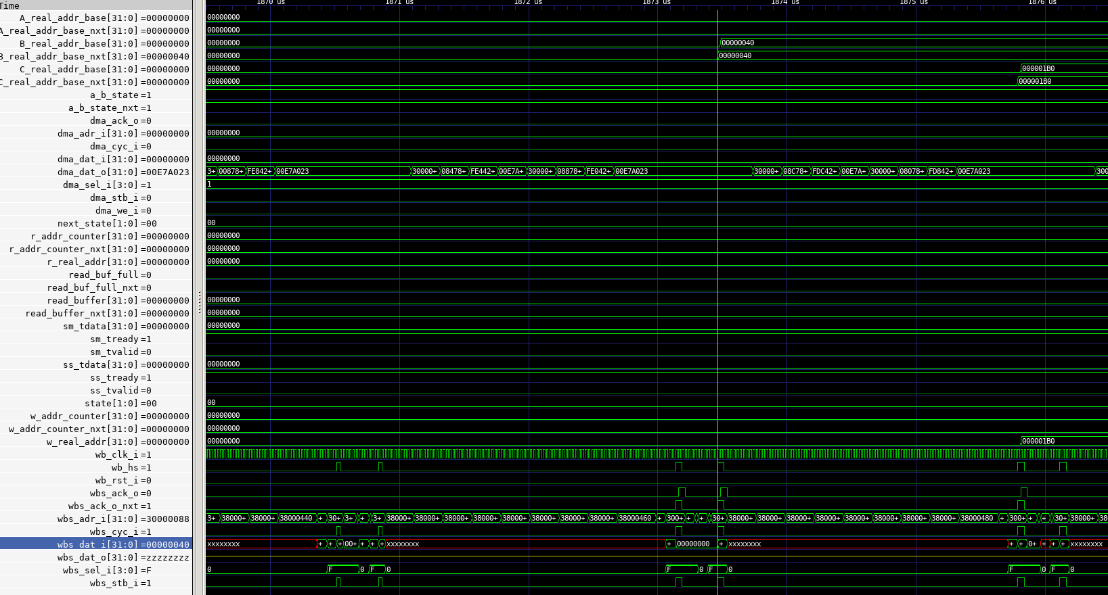
Problems Encountered:
遇到的其中一個問題：.data的位址在00000000 => 與保留段衝突
Solution: 多處檢查後發現是lab6跟final的crt0_vex.S, section.lds
 | -O1 | -O2 | -O3
3984 | 2318 | 2296 | 2296

Slide 22
Work distribution
鄭至盛 | 陳品睿
Accelerator, SDRAM(burst), exmem | DMA, arbiter

